Slide 1
Tuscany/Spring web application integration
Raymond Feng

Slide 2
Overview
Spring has a convenient way for a web application to initialize the ApplicationContext when the web application starts.
http://static.springsource.org/spring/docs/3.0.x/spring-framework-reference/html/beans.html#context-create
Tuscany creates a Node for a web application when it starts. If the deployable composites contain SCA spring components, Tuscany tries to build an ApplicationContext too.
We should allow the two containers to coexist and collaborate within the web application. The ApplicationContext created by Tuscany should be able to see the “global” WebApplicationContext. This way, we don’t have to load the Spring context twice and duplicate the definitions.

Slide 3
Runtime architecture
Component
(implementation.spring)
Tuscany
TuscanyContextListener/TuscanyServletFilter
Spring
ApplicationContext
ServletContext
Spring
ContextLoaderListener
Spring
WebApplicationContext
XML

Slide 4
A sample web application
SCA composite
HelloworldClientComponent
(implementation.spring)
DateServiceComponent
(implementation.java)
Tuscany
TuscanyContextListener/TuscanyServletFilter
Spring
ApplicationContext
(HelloworldClientBean)
ServletContext
Spring
WebApplicationContext
(HelloworldBean)
Spring
ContextLoaderListener
helloworld-client-context.xml
helloworld-context.xml

Slide 5
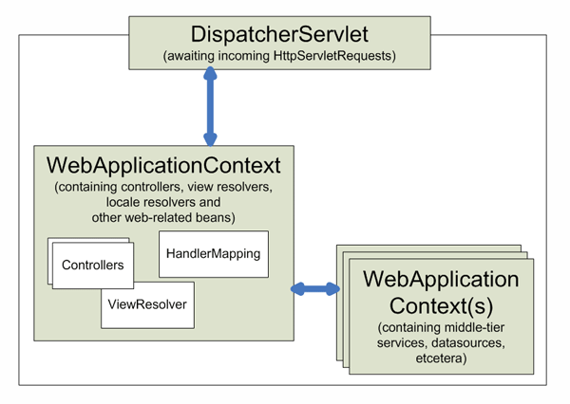
Spring MVC support
http://static.springsource.org/spring/docs/3.0.x/spring-framework-reference/html/mvc.html

Slide 6
Servlet-scoped Tuscany Node
TuyscanyContextListener/TuscanyServletFilter
(Middleware-tier)
Tuscany
Node
Spring Web
Application Context
parent
Spring MVC Servlet
Tuscany
Node
TuyscanyDispatcherServlet
extends
DispatcherServlet
(Spring MVC)
Spring MVC
Application Context

Slide 7
Sample application
https://svn.apache.org/repos/asf/tuscany/sandbox/rfeng/sca-java-2.x/implementation-spring/helloworld-spring-webapp/
<servlet>
<servlet-name>dispatcher</servlet-name>
<servlet-class>org.apache.tuscany.sca.host.webapp.spring.TuscanyDispatcherServlet</servlet-class>
<!-- Spring MVC DispatcherServlet config -->
<init-param>
<param-name>contextConfigLocation</param-name>
<param-value> /WEB-INF/spring/appServlet/servlet-context.xml </param-value>
</init-param>
<!-- SCA contribution -->
<init-param>
<param-name>contribution</param-name>
<param-value> /WEB-INF/sca </param-value>
</init-param>
<load-on-startup>2</load-on-startup> </servlet>
<servlet-mapping>
<servlet-name>dispatcher</servlet-name>
<url-pattern>/mvc/*</url-pattern>
</servlet-mapping>

Slide 8
Sample composite
helloworld-client-context.xml
helloworld-context.xml
HelloworldClient
Bean
Helloworld
Bean
Helloworld Client
Component
(SCA Spring)
DateService
Component
(SCA Java)
WebApp
Greeting
Component
(SCA Spring)
Servlet
sca-context.xml
servlet-context.xml
Spring MVC
Beans
Greeting
Service
Bean
Message
Service
Bean
Spring MVC
Beans
Spring MVC
Beans

